Slide 1
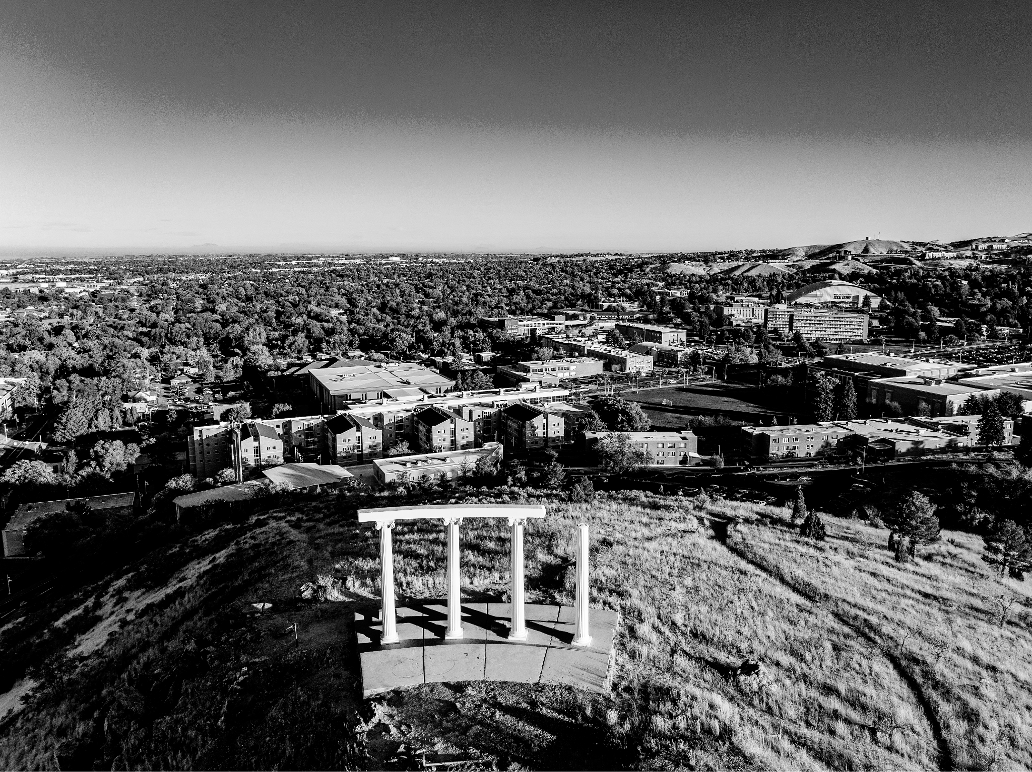
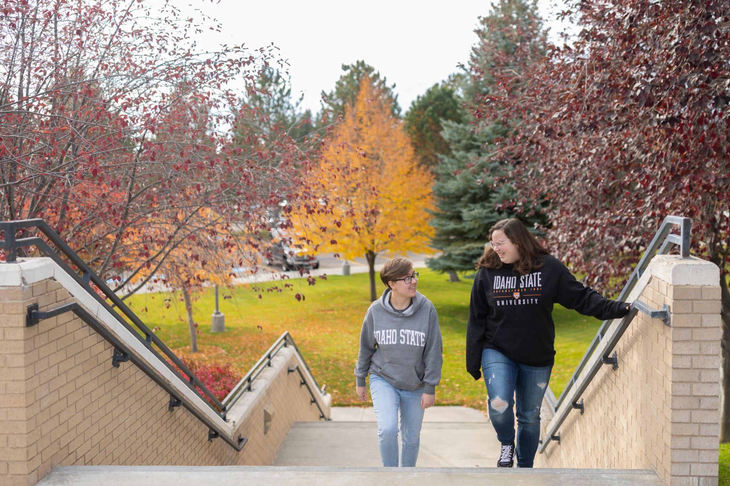

CREATING ACCESS AND IMPACT THROUGH OPPORTUNITY AND COLLABORATION
Robert W. Wagner, PhD
President

Slide 2
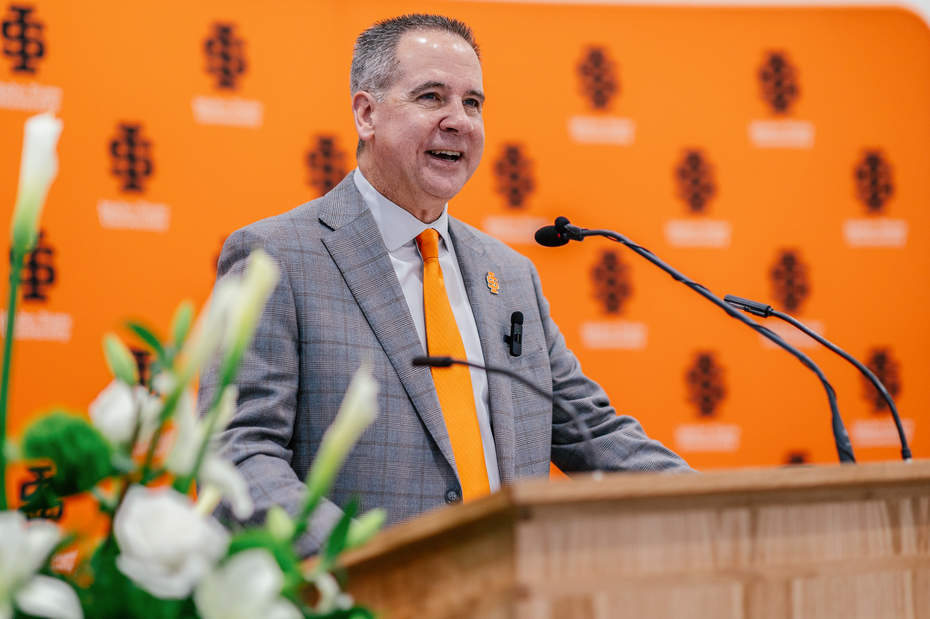
PROFESSIONAL JOURNEY
Teacher, administrator, entrepreneur and business owner
Leadership in multi-campus systems, enrollment management
Focus on data-informed decision-making and student success
Experience in strategic thinking, corporate partnerships and team building
EDUCATIONAL JOURNEY
BS in Psychology, BYU
MPA, University of Utah
PhD in Political Science, SUNY Albany
Continuing education: Harvard, ASU-Georgetown
Expertise: Government-higher ed-industry partnerships

Slide 3
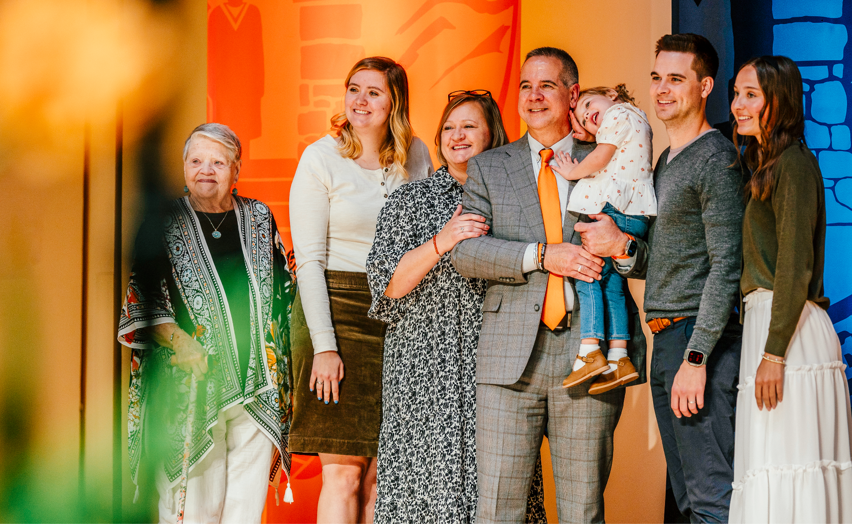
PERSONAL INSIGHTS
Married 33 years to Tracy, a music therapist (USU)
Proud father of five successful children in various professions
Caleb (Hayley): Entrepreneur - BYU/CPA - USU, granddaughter
Elisabeth: Master’s counseling, USU, University of Washington
Benjamin (Tiffany): Tech Ed, sales industry, 4 grandchildren
Justin (Clara): Programming bootcamps (graduate school)
Tabitha: Grad student, B.S. Political Science, USU

Slide 4
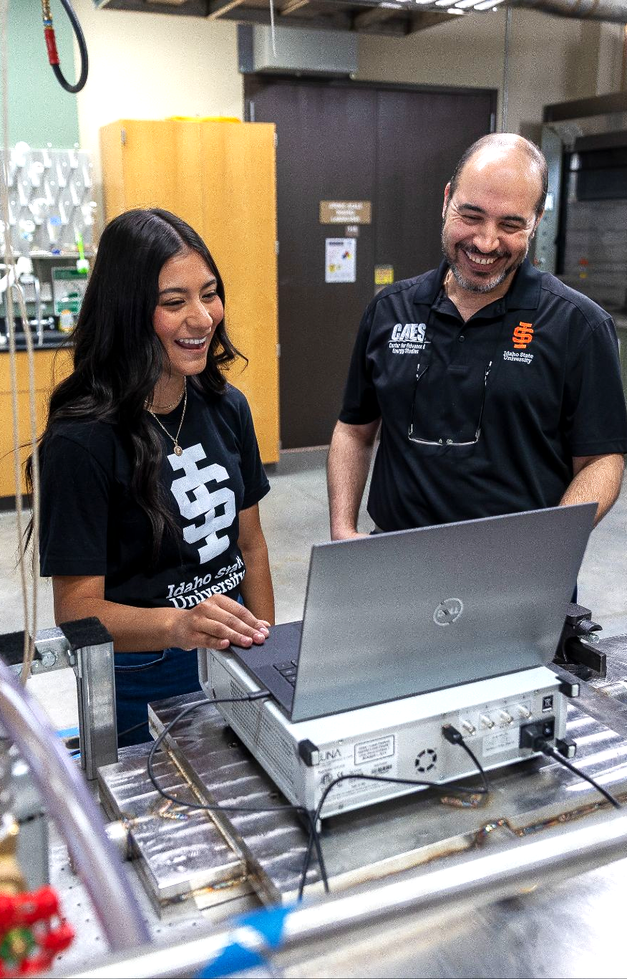
IMPERATIVES FOR HIGHER EDUCATION
Demonstrating community and state impact
Changing demographics
Controlling costs - finding efficiencies
FINDING SOLUTIONS IN HIGHER EDUCATION
Transformational AND transactional
The value of a COMPREHENSIVE PUBLIC UNIVERSITY
Do not be afraid of change
Transparency matters
Value people
PARTNERSHIP AND COLLABORATION
Access - online, f2f, hybrid, alternative credentials, fast-tracks

Slide 5
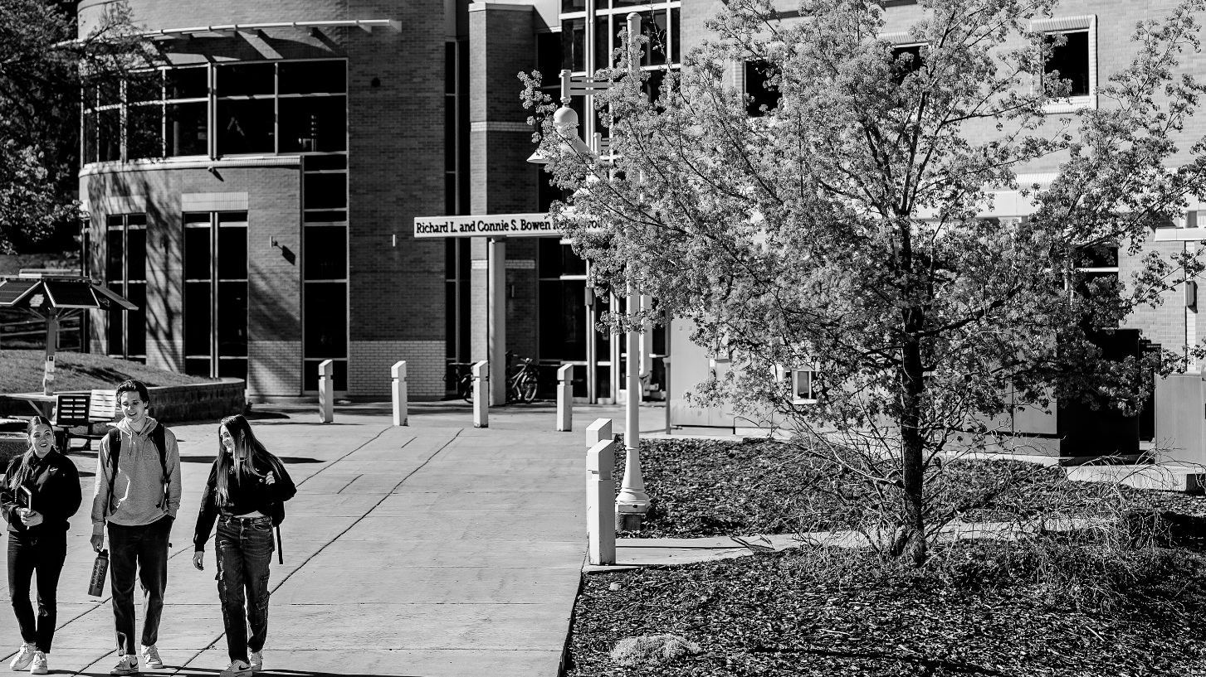
IDAHO STATE UNIVERSITY AREAS OF FOCUS 2025-26
Enrollment Growth & Student Success
Academic & Research Enterprises
Advancing/Enhancing Physical Infrastructure
External Relations & Partnerships
Employee Engagement, Empowerment & Connection

Slide 6
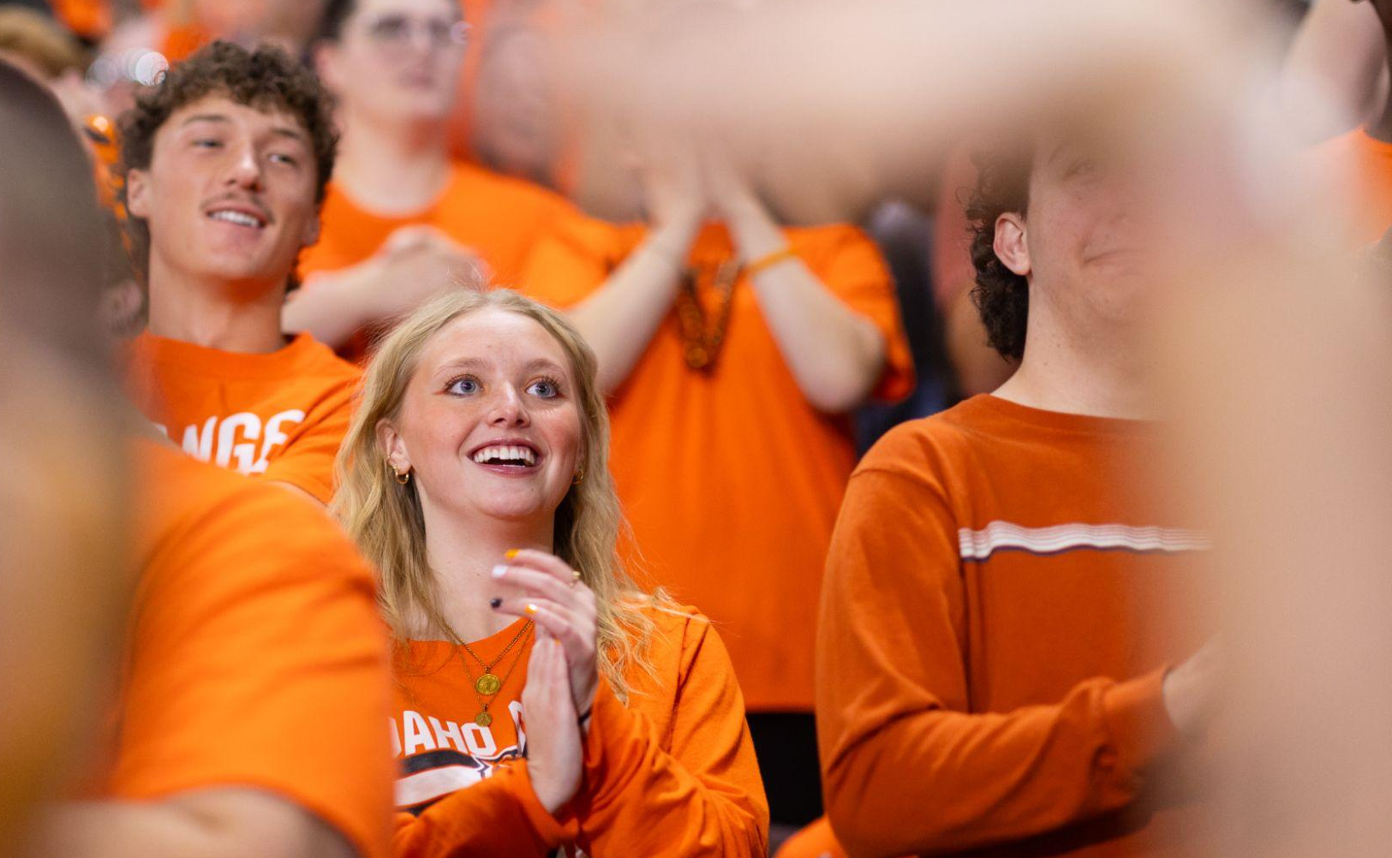
ISU ACHIEVEMENTS IN 2025
Fall enrollment is 10,402, an increase of 521 students or 5.3% compared to last fall.
Total undergraduate enrollment is 9,152, the highest since Fall 2015
New first-time undergraduate enrollment is the highest since Fall 2011
Continuing undergraduate student enrollment is the highest since Fall 2018
Total undergraduate degree-seeking enrollment is the highest since Fall 2017
The retention rate for Tenth Day Fall 2025 is 74.1% - a 2% increase and the highest rate we have ever seen at ISU!
Financial Growth
Endowment funds up 12%
$11M increase in research expenditures
ISU expanded partnerships with the Idaho National Laboratory (INL), the Idaho College of Osteopathic Medicine (ICOM), Lewis-Clark State College, College of Eastern Idaho, Boise State University, and College of Southern Idaho to expand academic programs and research.
Three 90-Credit BAS degrees (Applied Business, Digital Systems, Law Enforcement Management)

Slide 7
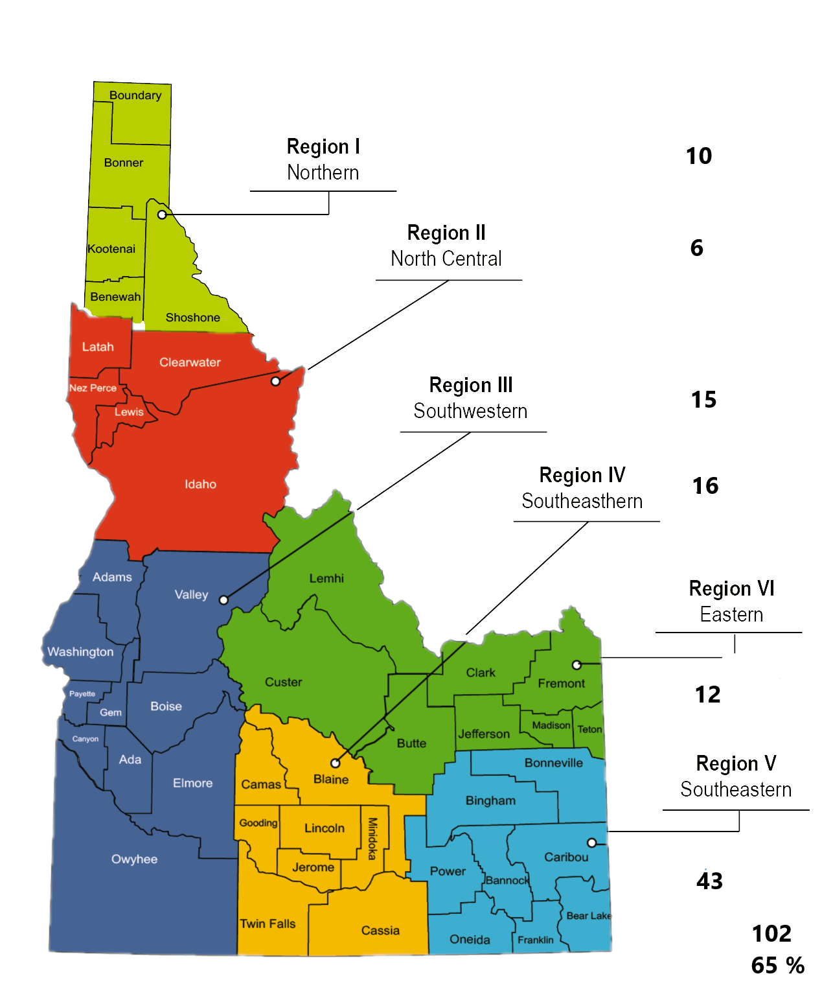
ISU’S HEALTH SCIENCES ROLE & PARTNERSHIPS
Broadest health portfolio in Idaho (50+ programs, statewide clinics, residencies).
2,000+ students training in Idaho communities each year.
Graduate Medical Education (Residencies): ISU Family Medicine, over 100 doctors in Idaho
Manages 10 MD seats at U of U
Psychiatry with U of U
Partnerships with LC, College of Idaho, BSU, Community Colleges, etc.
ICOM Partnerships already in place:
Shared campus (leased ground in Meridian).
ISU holds 2 board seats.
Joint degrees (DO-MPH, DO-MHA).
ISU is ready to do MORE!
ISU Family Medicine Grads Since 1994

Slide 8
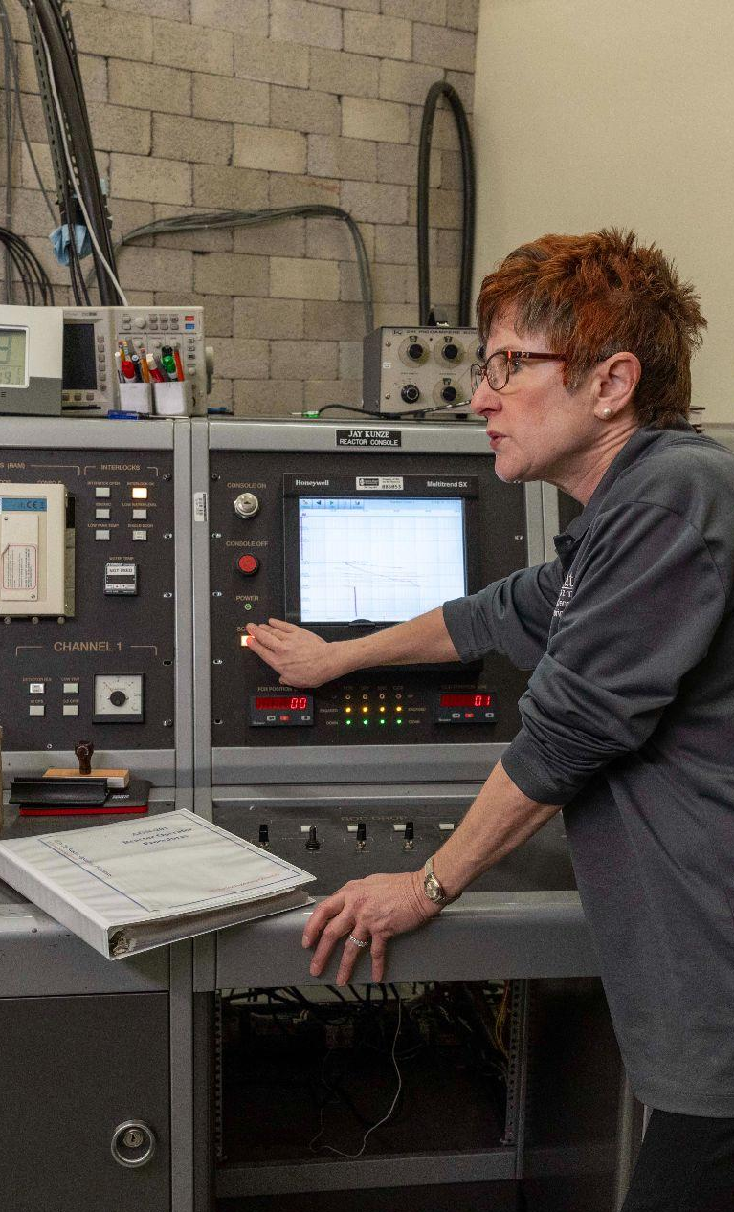
IDAHO’S NUCLEAR UNIVERSITY
Accredited, nationally-recognized education programs span operations to engineering: Associate to PhD
One of 25 U.S. universities with a research-test nuclear reactor
One of only six with a reactor and subcritical assembly; the ONLY one using fuel anticipated for next generation advanced reactors
Idaho Accelerator Center:
Nuclear materials research for new reactor design & national security
Radiobiology for investigating irradiation effects
Medical isotope production for cancer research
Notes:
Nuclear Engineering Department
Unique Fuel Source: ISU is the only university in the U.S. with a subcritical assembly using 20% enriched uranium, which is important as the nuclear industry moves towards this type of fuel for advanced reactors.
Combined Facilities: ISU is among a small group of only six universities nationwide that have both a nuclear reactor and a subcritical assembly.
Significance for Training: The presence of both facilities allows ISU to provide unique training opportunities, especially for industry professionals on safe nuclear fuel handling for advanced reactors.
Nuclear Operations Technology, a Northwest Regional Center of Excellence for Nuclear Education and Training.
100% placement or continuing education rate.
The average income is about $90,000/year

Slide 9


Slide 10

ISU - IDAHO FALLS
Eastern Idaho’s University. A critical partner
in workforce development, economic growth
and community vitality.
603
Face-to-face student advising appts. on campus
821
Students marked “Idaho Falls” as their preferred ISU campus at registration
6,827
Credits taken from Idaho Falls courses
1,132
Students took courses from the Idaho Falls campus

Slide 11
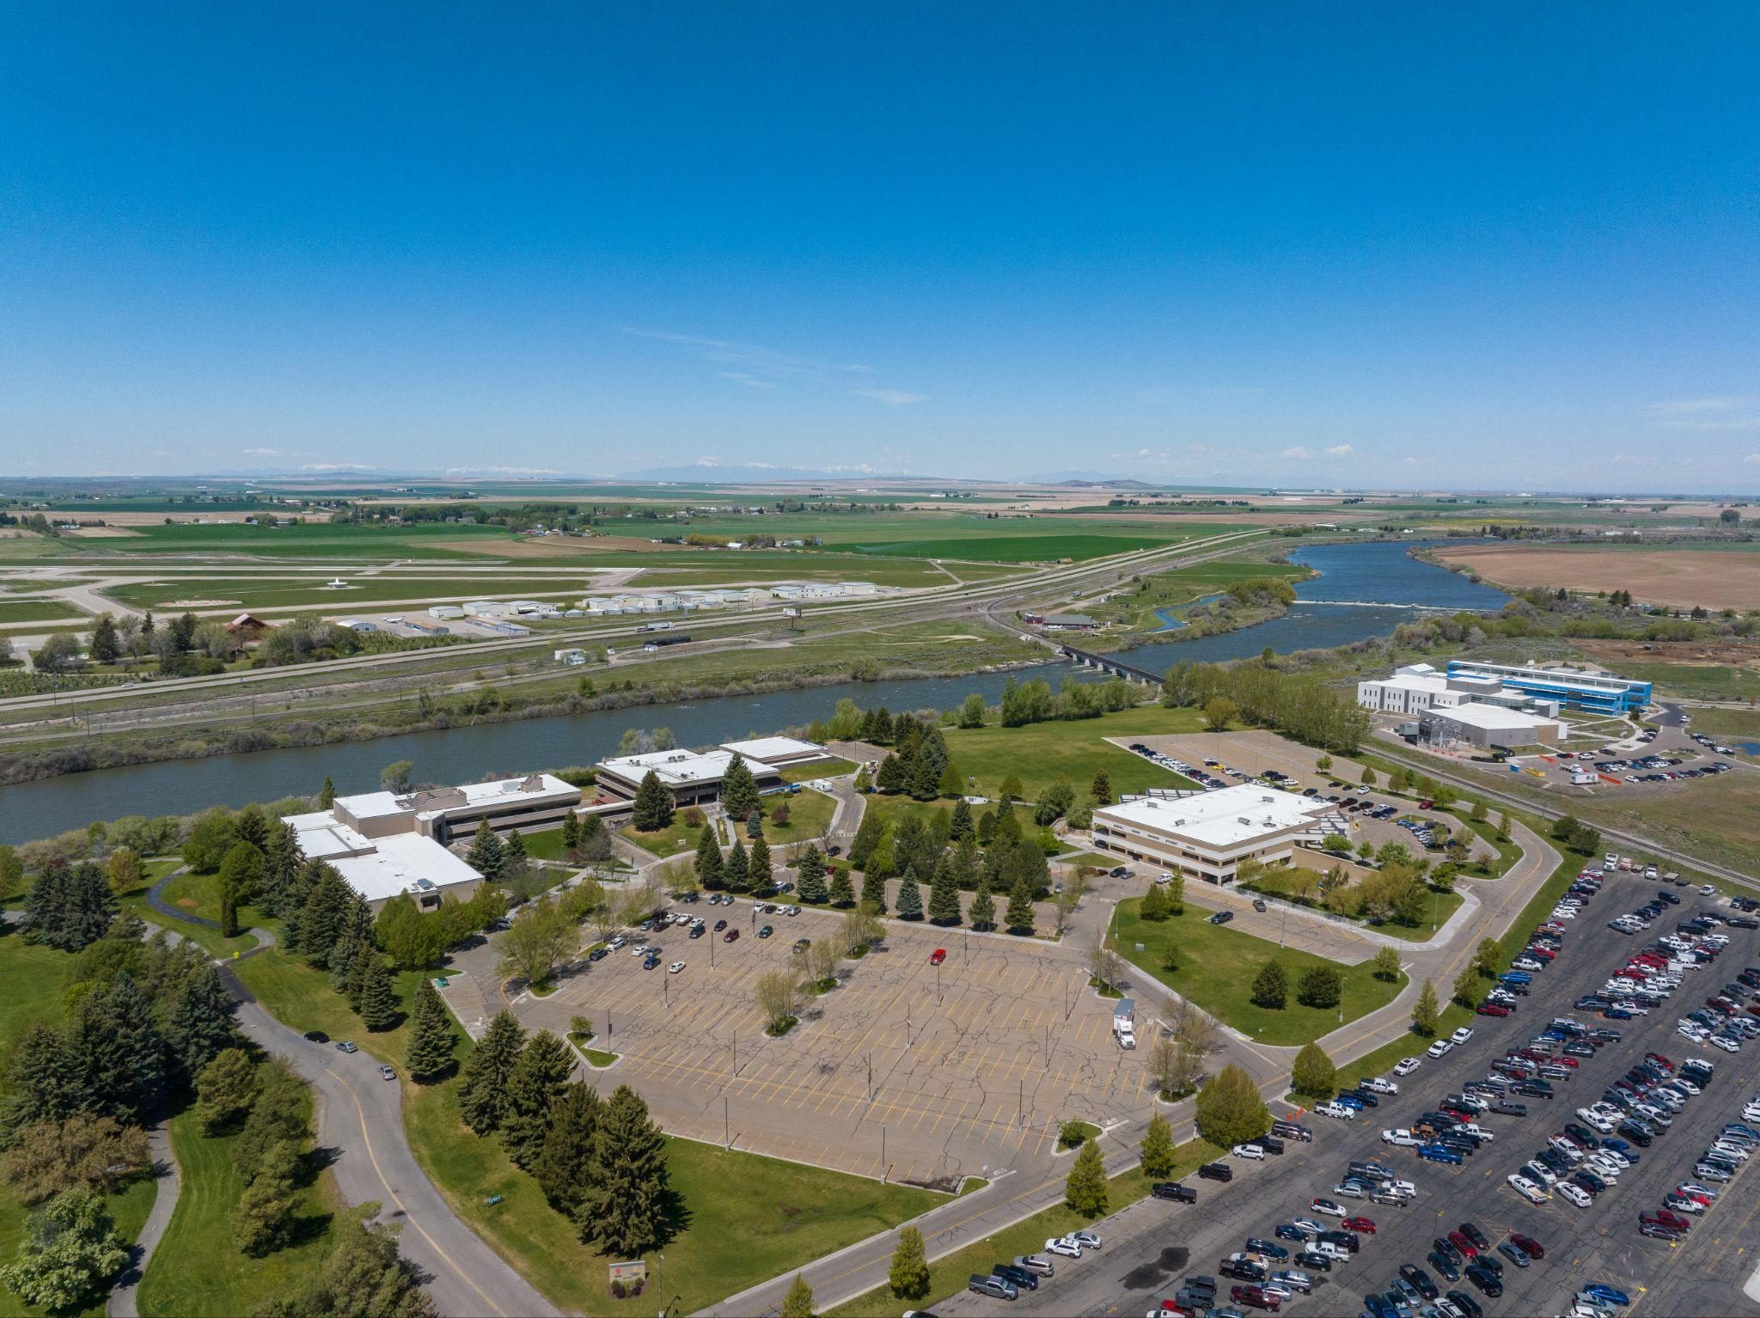
ISU - IDAHO FALLS
PUBLIC UNIVERSITY ACCESS FOR EASTERN IDAHO
ISU will be THE provider of 4-year degrees in the Idaho Falls region
Focused on diverse delivery methods to meet students where they are
Cater to traditional and non-traditional students
Close partnership with sister institutions promoting seamless transfer pathways
K-12 pipeline development - Summer 2025, established a new position in Idaho Falls dedicated to supporting K-12 partnerships
Comprehensive student support services
Advising, financial aid, testing, tutoring, on-site full service library, TRIO, Veteran services, personal and career counseling

Slide 12
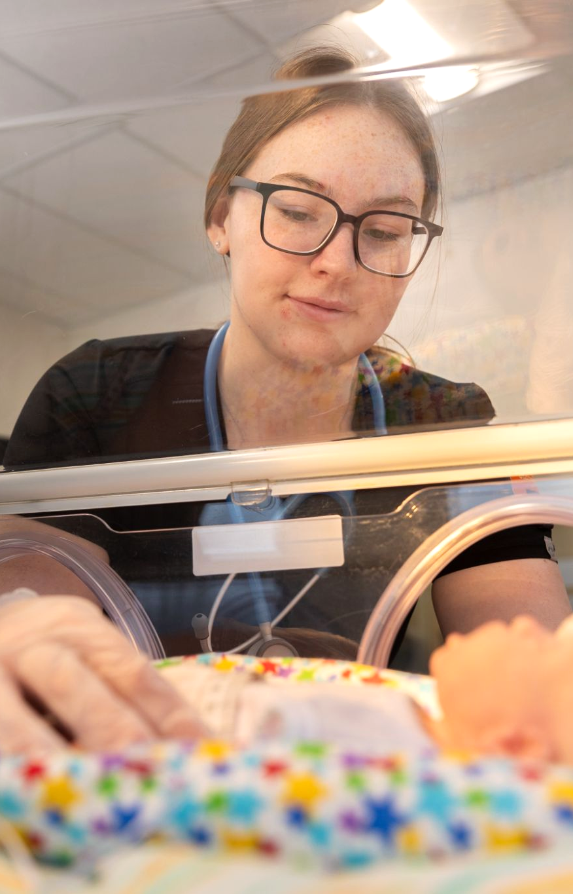
ISU - IDAHO FALLS
CEI AND BYU-I PARTNERSHIP - AREAS OF FOCUS
Program collaborations:
Health Sciences and Health Professions
Engineering and Computer Sciences
Business
Technology
Education
Streamlined Student Services
Co-enrollment
Joint Advising
Financial Aid Consortium Agreements

Slide 13
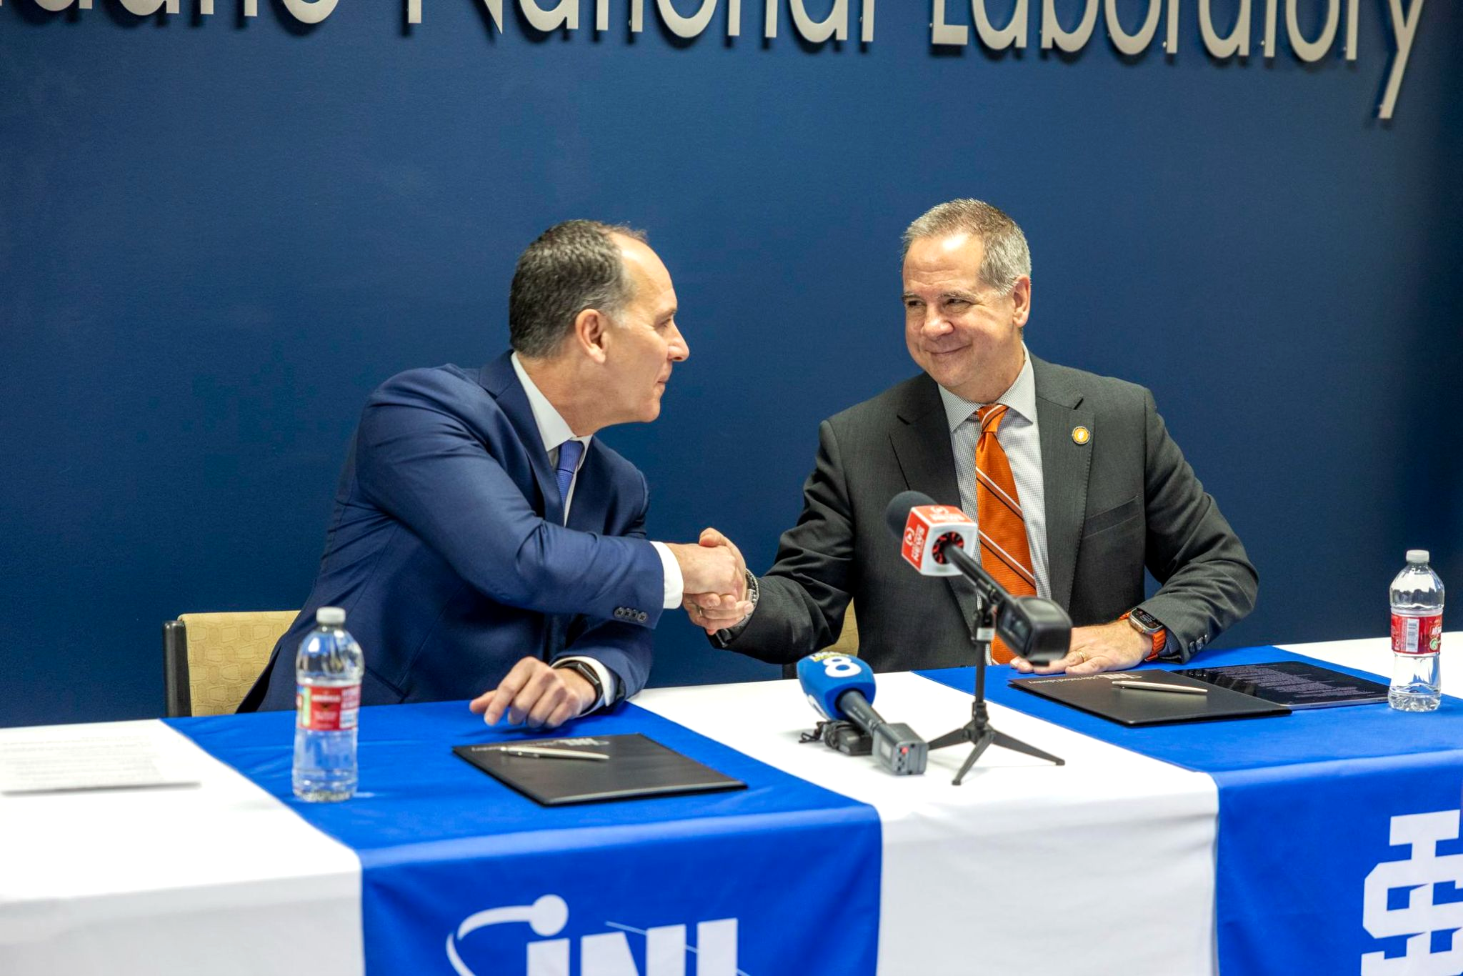
ISU - IDAHO FALLS
INL PARTNERSHIPS
SUPER Agreement - December 2024
Critical & Strategic Materials and Minerals
Energy-Environmental Security
Critical Materials & Energy Systems Innovation Center
Two internal INL R&D grants
20 current/pending joint-appointees
New nuclear research labs
80 INL interns
Annually host STEM Summer Camps
YMCA operated childcare
Notes:
SUPER: Strategic Understanding for Premier Education and Research
Two internal INL R&D grants. ISU is the lead external partner on both:
Reactor construction: “Accelerating Nuclear Construction with Pre-cast Composite Concrete Walls with Mechanical Connections"
Rare earth mineral recycling. "Novel process for rare earths and radionuclides recovery from phosphogypsum: phosphogypsum molten salt leaching and reduction"

Slide 14
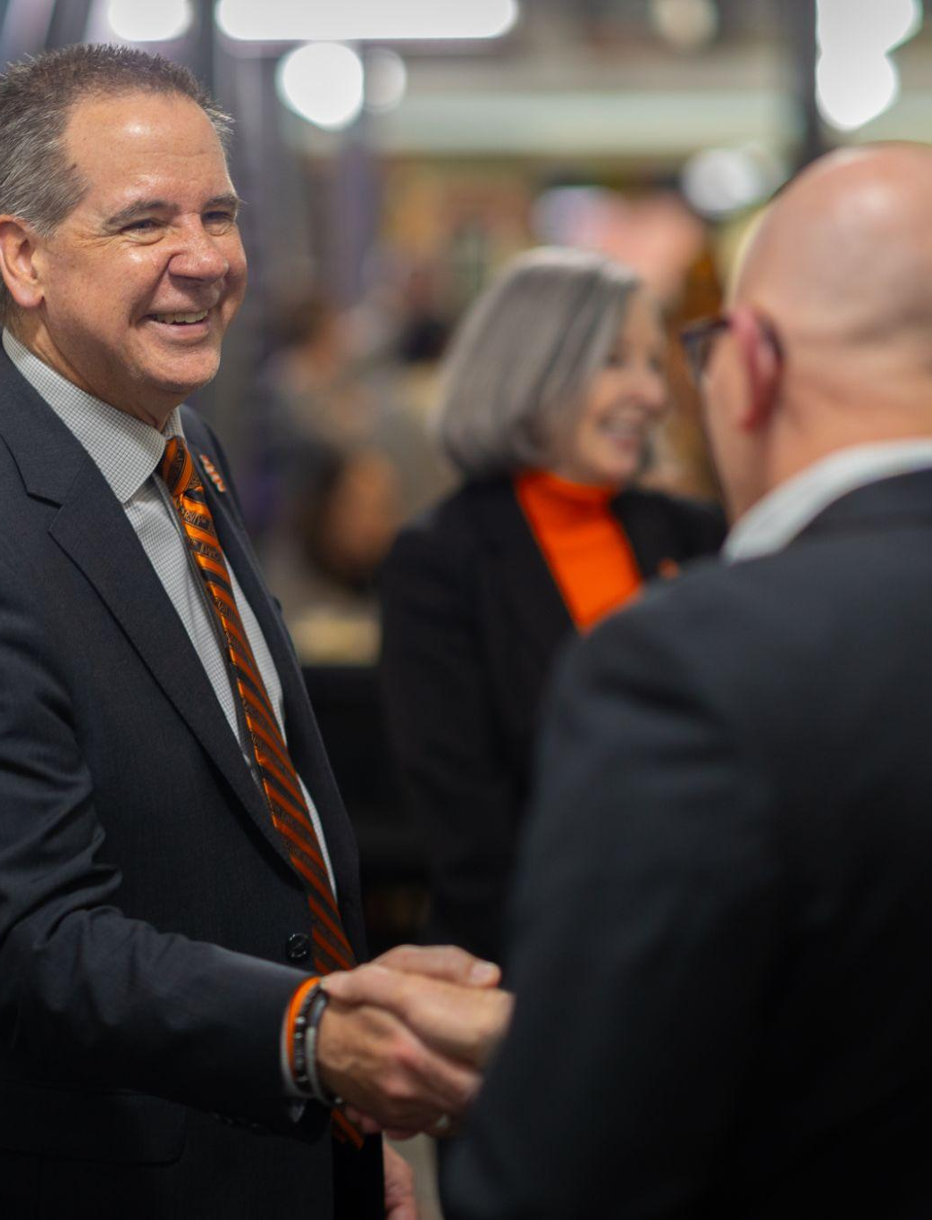
ISU IS EASTERN IDAHO’S PUBLIC
4-YEAR UNIVERSITY
ACTIVE ENGAGEMENT ACTIVITIES:
Active in local civic groups
Meeting with local, regional, state and national public officials
Engaging with K-12 advisory groups
Mobilizing regional alumni activities
Connecting with local business and industry partners

Slide 15

THANK YOU
Looking forward to working with you and for you!

