Slide 1


91.1 Pocatello • 91.3 Idaho falls • 88.1 Rexburg • kisu.org
Jamon Anderson • KISU-FM General Manager
Jamonanderson@isu.edu • (208) 282-2688

Slide 2


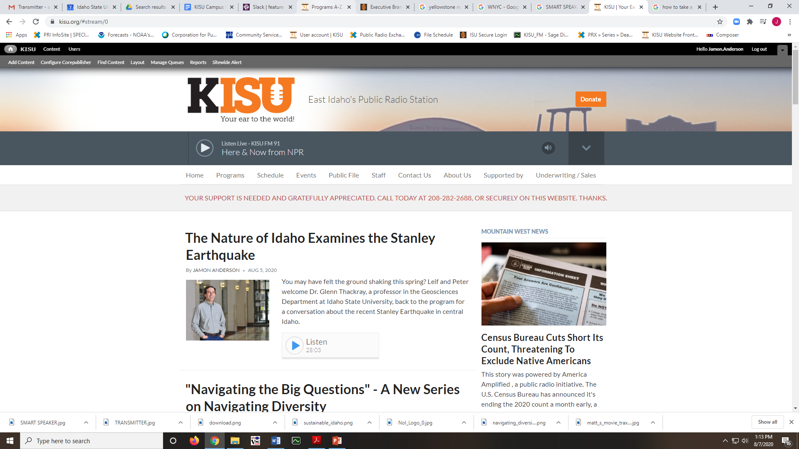
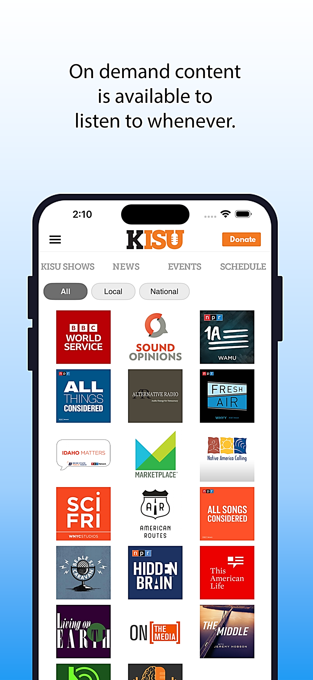
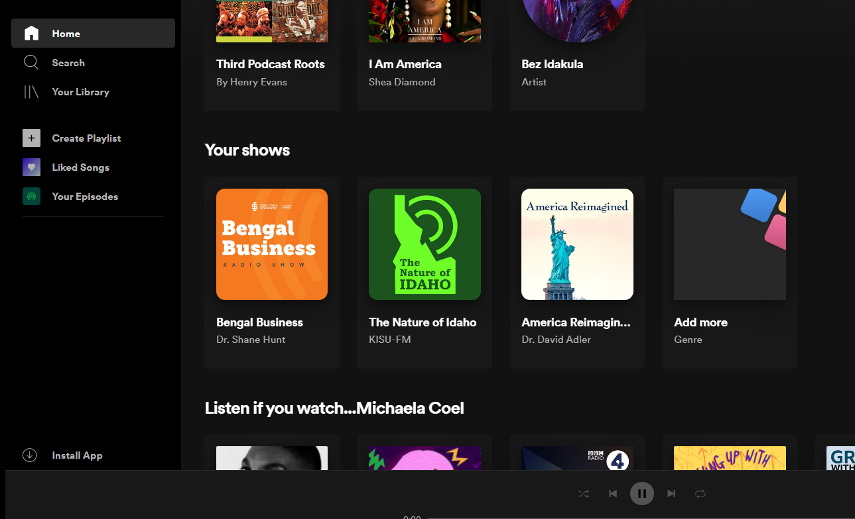

Slide 3







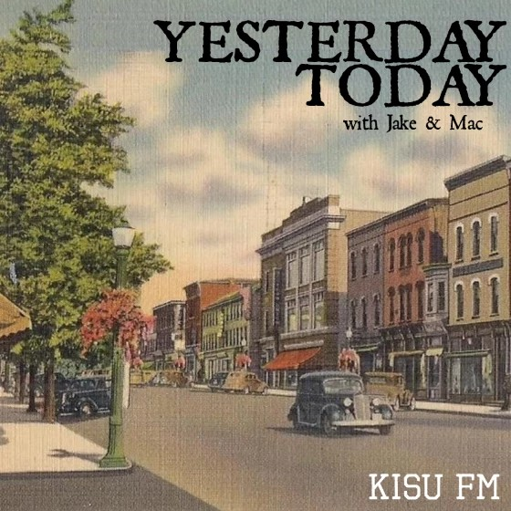


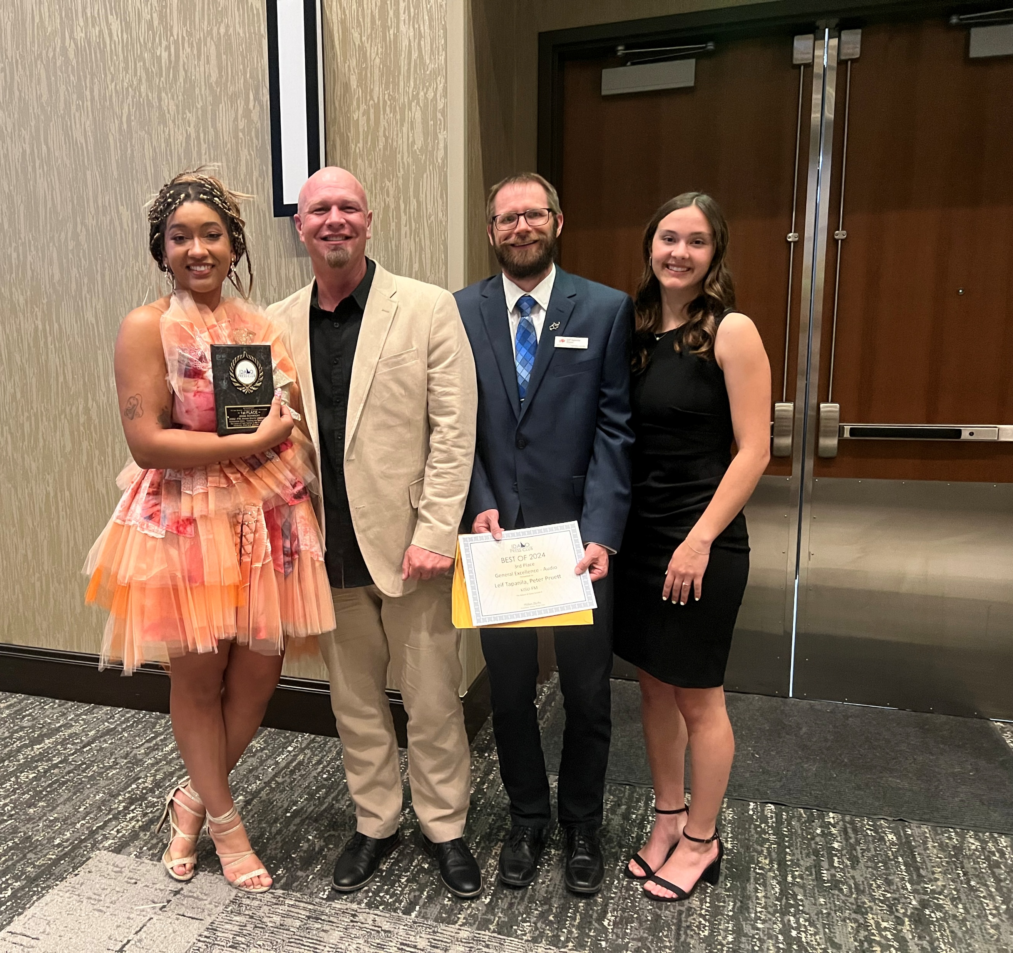


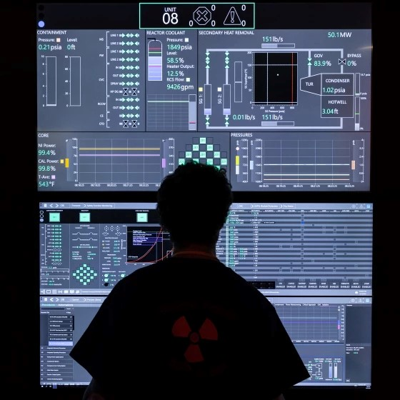




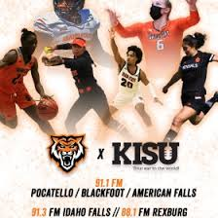






25 volunteer show hosts and dozens more working behind the scenes
Hundreds of ISU faculty, students, staff, and community members participate as a guest on KISU radio programs and podcasts every year or participate in an academic experience.
20+ local programs including award-winning programs from volunteers and students
8,000+ PSAs (=$120k) for local nonprofits & educational entities
KISU INVOLVEMENT

Slide 4

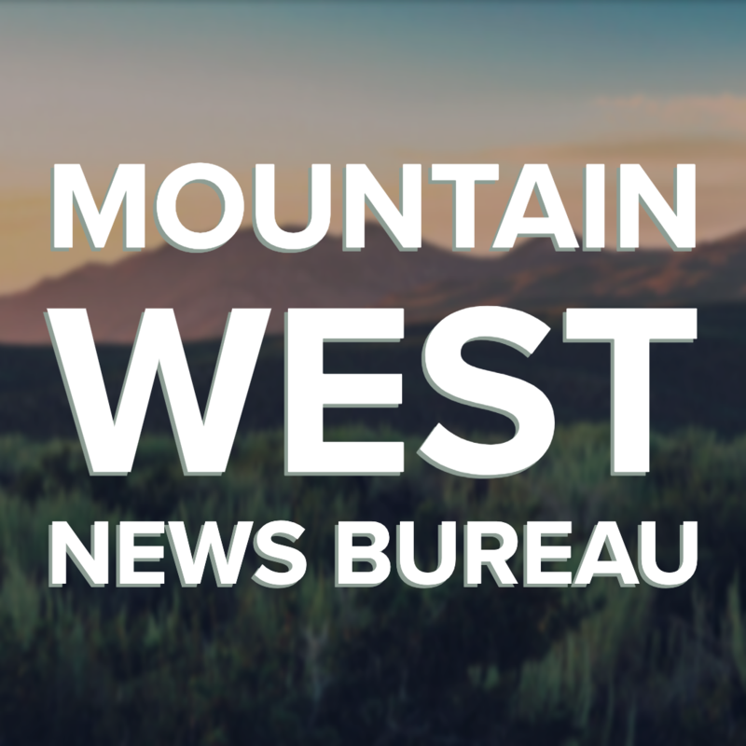






KISU-FM Programming
Affiliations

Slide 5
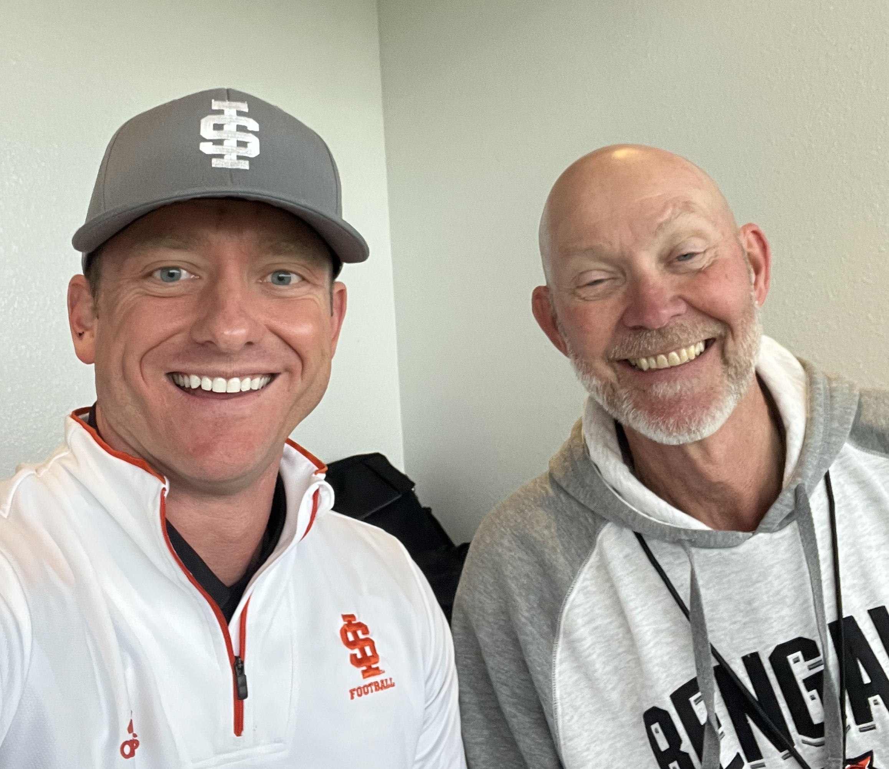

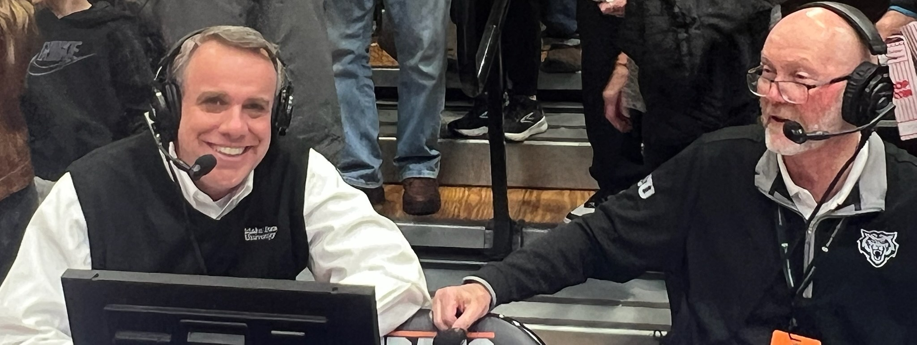

Slide 6

KISU-FM Major Milestones
1980s – ISU planning begins
1996 - KISU studio production begins at PSUB
1999 - Went on the air in June
2000 - First student hosted show began
2001 - Began airing ISU Women’s Athletics
2006 - Idaho Falls translator
2008 - On-air fundraising
2010 - CPB funding awarded
2010 - Second fulltime employee
2010 - Local news added to mornings
2013 - Website and live stream
2015 - Rexberg translator
2019 - Men’s Athletics
2020 - Nature of Idaho wins first IPC Award
2021 - Transitioned to University Advancement
2022 - Digital studio upgrade
2024 - Hight of local programming production
2025 - CPB funding cut in July

Slide 7

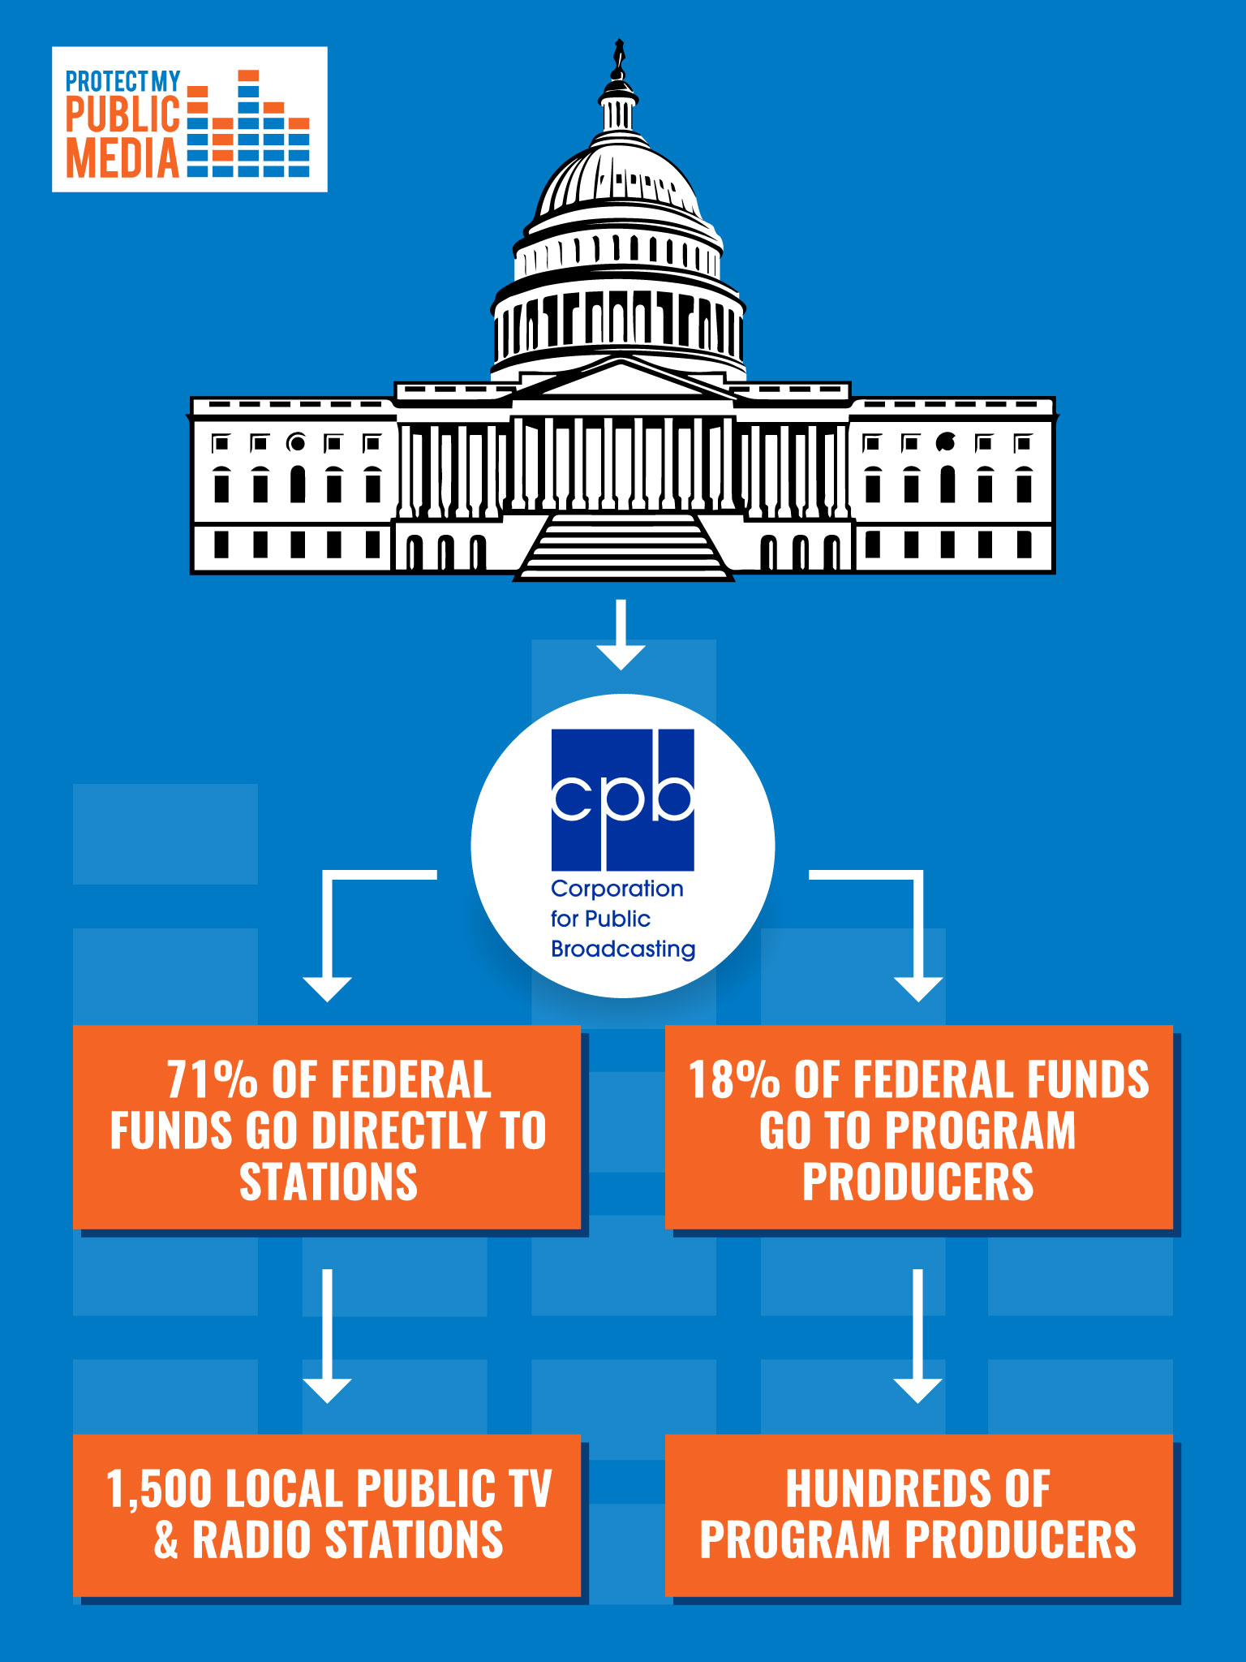
Corporation for Public Broadcasting Funding
CPB funding proposals include two fiscal years. This is a form of insulation from political forces. 1.1 billion was approved for FY25 and FY26.
CPB Grant Requirements for Stations
•Minimum non-federal revenue requirements (>300k)
•Annual application process including independent financial audit
•Use of CPB funds on approved purchases
•Provide measurable services to communities
•Posting requirements on stations’ websites
•Reporting requirements for music usage and streaming
Factors in CPB Grant Awards
•Rural and tribal status (KISU = rural status)
•Population density (KISU = 231,000)
•Primary programming format (KISU = news)

Slide 8
CPB Funded Services Breakdown
Service Category | Proportion of Funds | Description
Local Public Radio/TV Stations | 71% | Direct grants to more than 1500 local public radio and television stations. Supports local programming, news, education, public safety, equipment, and outreach.
Programming development | 18% | Investment in content creation across TV, radio, and digital platforms.
System-wide support & infrastructure | 6% | Funds for interconnection, research, copyright, technical support, and major projects like digital transition, satellite systems, emergency alerting, and minority service initiatives.
CPB Operations | <5% | Administration, oversight, and grant facilitation; ensures neutrality and accountability.

Slide 9
Rescissions Act of 2025 includes a provision to claw back public media’s FY26 and FY27 federal funding
Rural, small-market, tribal, and minority-serving stations will be disproportionately affected, and several major outlets have already announced layoffs and service reductions.
NPR receives about 1-2% of its budget directly from federal grants, including CPB. Member stations receive an average of 8-10% of their funding from CPB.
CPB support amounted to roughly 20% of the total direct revenue for public broadcasting in the United States.
At least 115 public radio stations nationwide are at immediate risk of closure due to CPB funding cuts, particularly those that relied on federal support for more than 30% of their budget.

Slide 10

A new national survey reveals voters more widely trust public media compared with media in general when it comes to reporting the news “fully, accurately and fairly”
– only 35% of voters trust media in general, but 53% of voters trust public media networks and local stations.
The survey also finds that 53% of U.S. voters oppose eliminating all federal funding for public media, compared with 44 percent in support.
According to the poll, conducted online by Peak Insights, voters highly value:
• emergency alerts (82%)
• children’s programming (66%)
• local programming (66%)
• national news reporting (60%)

Slide 11

Idaho Public Broadcasting Organizations and CPB Funding
Entity | CPB Funding Share | Impact of Funding Cuts
KISU-FM | 25% of annual funding | Disruption of services, programming, and community partnerships
Boise State Public Radio | 20% of annual funding | Threatens operations and support of the Mountain West News Bureau
KIYE-FM, Lapwai | 51% of annual funding | Risk to "Voice of the Nimiipuu" and tribal public radio initiatives
Idaho Public Television | 20% of annual funding | Endangers network maintenance, public safety, statehouse coverage, and local shows

Slide 12

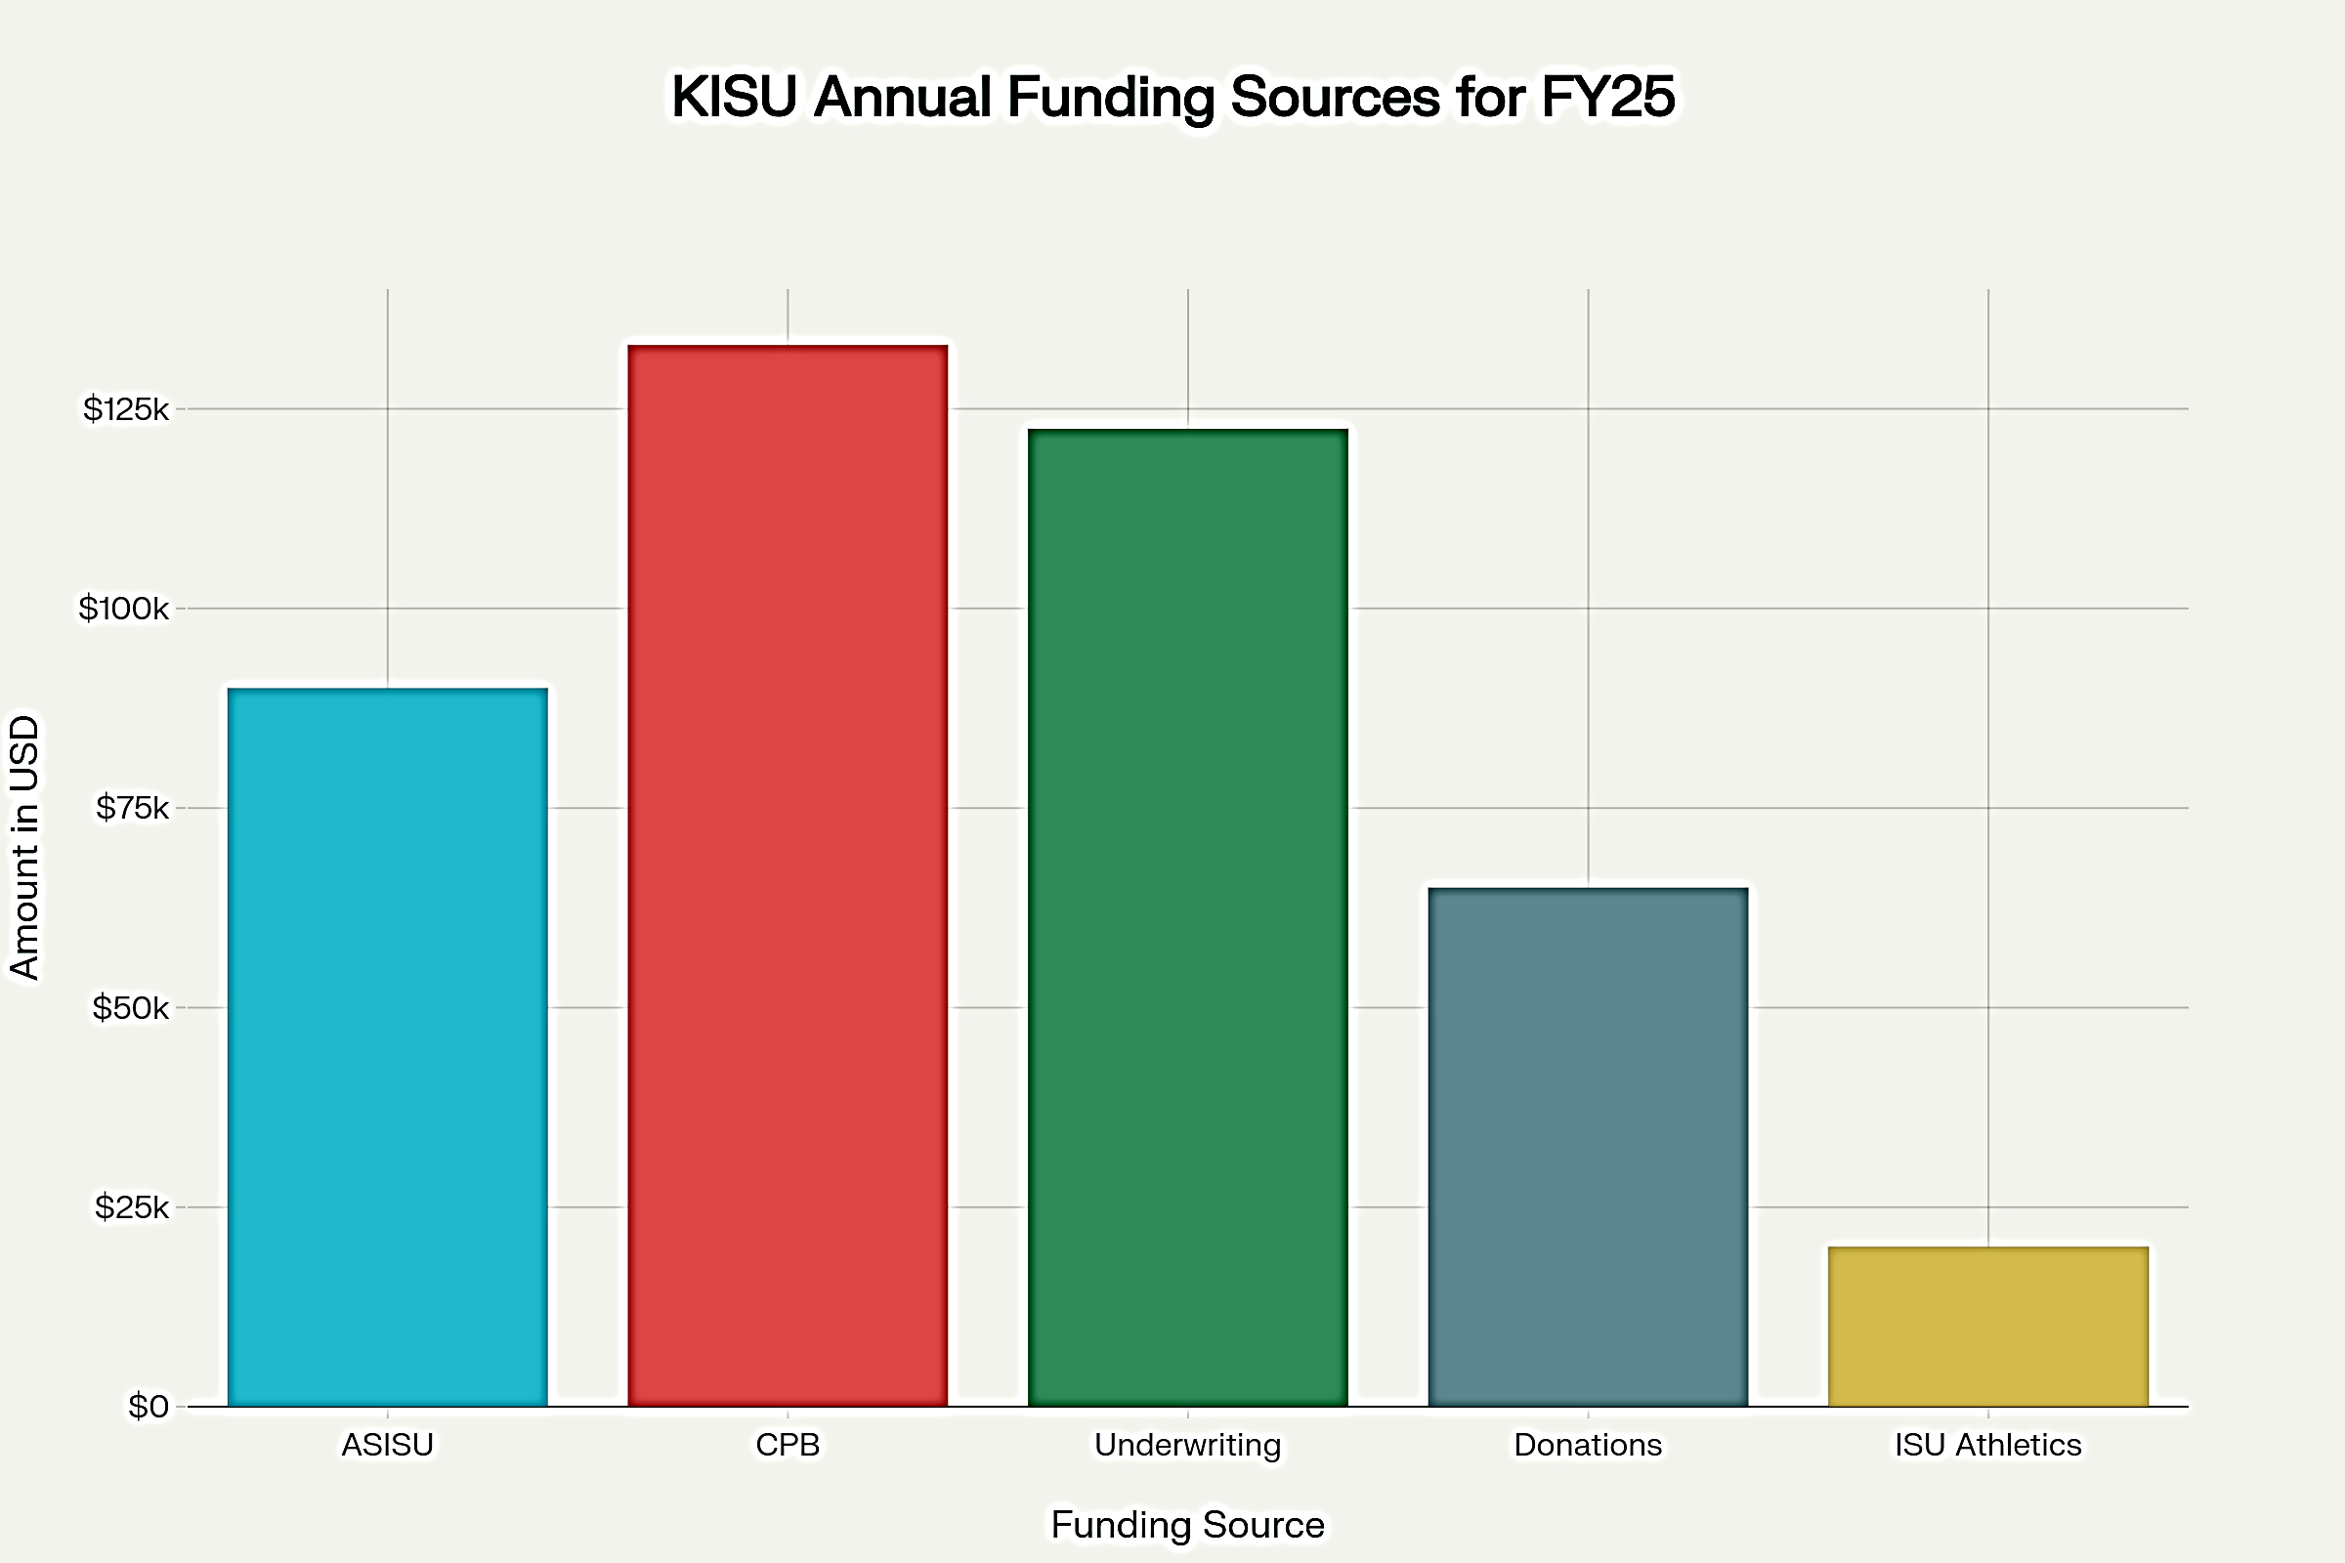
KISU-FM funding sources:
How much CPB funding does KISU receive?
In fiscal year 2025, more than one-quarter of KISU’s budget came from the CPB grant funding.
In addition to community service grants, CPB funds satellite connections, independent programming production, music rights and more.
The loss of CPB funding and services may have an annual impact of close to $150,000.

Slide 13

The loss of CPB funding will impact KISU:
National Programming
Local Programming
Digital Content/Website
Satellite Delivery System
Music Programming
Local News
Community Partnerships
Services for Nonprofits & Educational Organizations
Public Safety, Emergency Alerts & Disaster Reporting

Slide 14
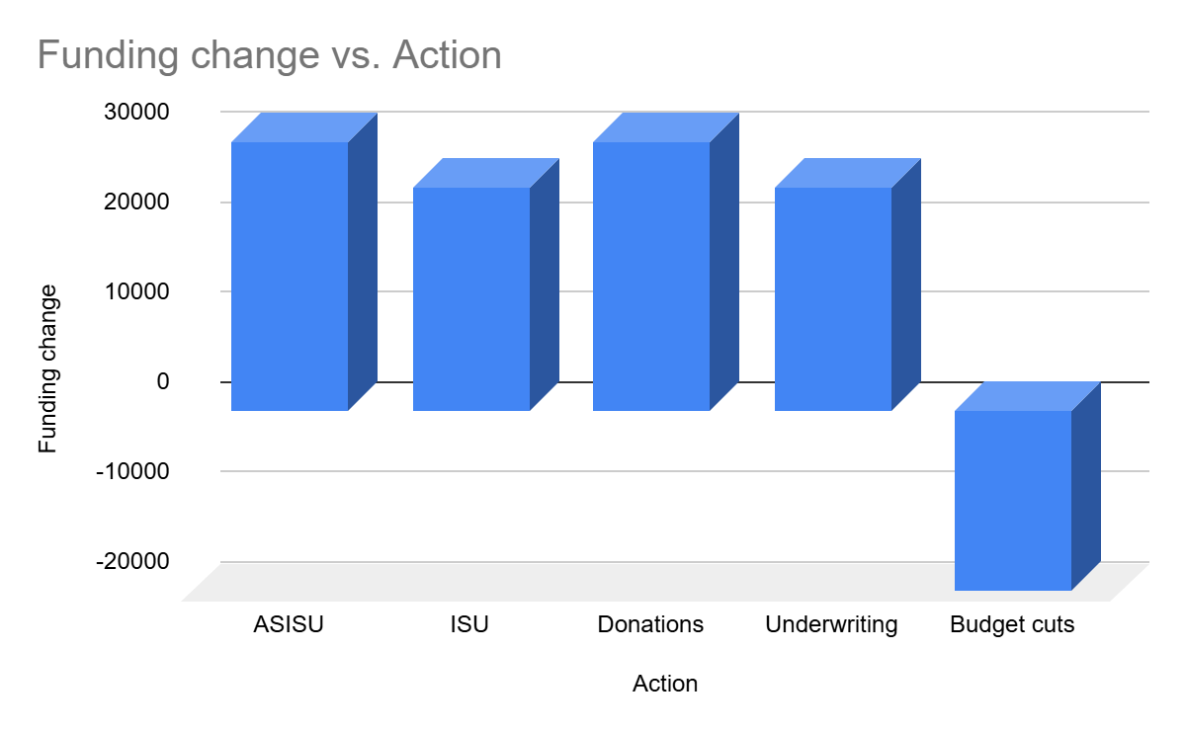
Budget Timeline:
October 1, 2025 NPR Fiscal Year begins, FY26 fees are determined
January 1, 2026 Year-end fundraising campaign will conclude, ISU budgeting begins
March 1, 2025 KISU presents FY27 budget, requests funding from ASISU
Source
ASISU | +30000
ISU | +25000
Donations | +30000
Underwriting | +25000
Budget cuts | -20000

Slide 15

Tough internal questions:
What can KISU realistically cut?
Will cuts impact other revenue sources?
Will listeners support KISU after cuts to local news and programming?
Will KISU’s request to ASISU for additional funding be successful?
What level of sustained general funding can our license-holder provide?
Will other pressures from the State of Idaho impact a request for general funding?
Should we pay for an independent audit if it’s not required by CPB?
As KISU seeks a sustainable future, how do we navigate long-term agreements? Should we postpone planned purchases and needed improvements?
Frequently asked by supporters and media:
How much funding does KISU need to raise to offset the cuts to CPB?
Do you expect CPB funding to return?
Has ISU been supportive?
Will another public radio station move into the area if KISU goes off the air?
Will KISU cut ISU Athletics?
Has KISU received more support since Rescission Act in July?
Could you go off the air at the end of FY26 (June 30, 2026)?
What can I do to help?

Slide 16

HOW TO PROVIDE SUPPORT:
Support KISU-FM with a financial contribution at KISU.org
Include KISU in your charitable giving plans for 2026
Encourage businesses and organizations to support KISU
Thank businesses that financially-support and partner with public media
Advocate and share with others the value KISU brings to our community
Be patient with public media outlets as we adjust to new challenges, especially as they relate to programming and staff.

Slide 17

Jamon Anderson
KISU-FM General Manager
KISU-FM, Idaho State University
Campus Box 8014, 83209
(208) 282-2688
jamonanderson@isu.edu

